Slide 1

Extraction of TiO2 from Ilmenite In Aruwakkalu Quarry
Ratheeskaran. L UWU/MRT/20/002
Department of Applied Earth Sciences Uva Wellassa University

Slide 2
Content
Introduction
Research Problem
Objectives
Materials and Methods
Expected Outcome
References
1
1

Slide 3
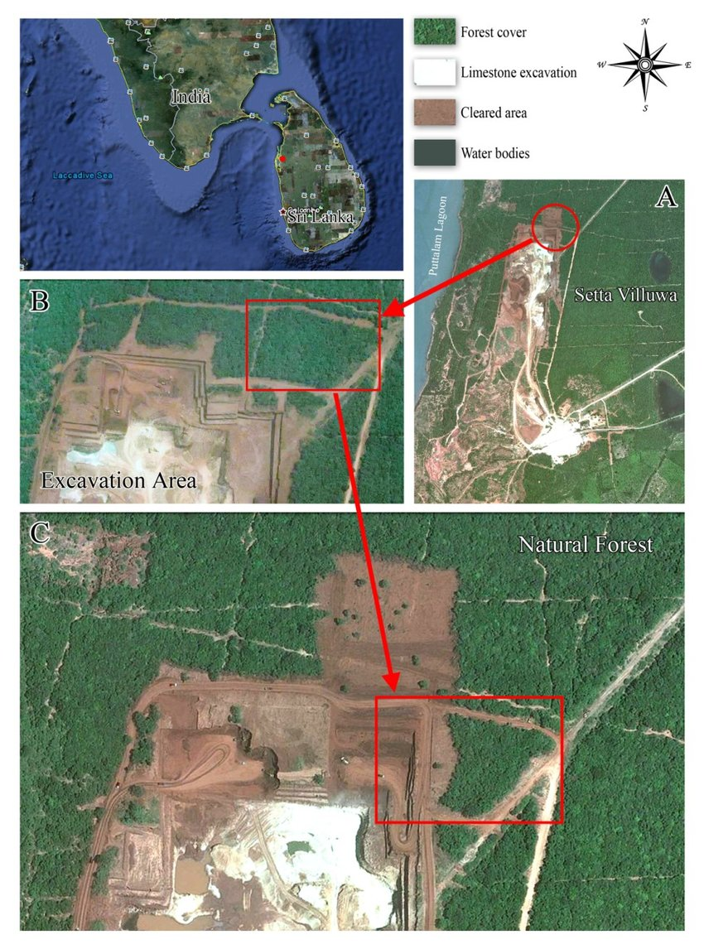
Introduction
The Red earth (RE) deposit that exists along the northwest coastal belt of Sri Lanka. ^{[1]}
The largest open pit limstone mine in Sri Lanka operated by Siam City Cement Lanka Limited. ^{[2]}
The red soil overburden is directly excavated and low grade and high grade limestone layers are drilled and blasted for extracting limestone. ^{[2]}
Iron-aluminum oxides brings the characteristic reddish color.
[1]L. Gunatilake et al., "Map of the Holcim limestone excavation site, Eluwankulama, Aruwakkalu Forest, Puttalam," *ResearchGate*, 2010. [Online]. Available: https://www.researchgate.net/figure/Map-of-the-Holcim-limestone-excavation-site-Eluwankulama-Aruwakkalu-Forest-Puttalam_fig20_256454738.
[2] P. M. D. C. Perera, "Study on the properties of steel reinforcement bars produced in Sri Lanka," University of Moratuwa Institutional Repository, 2020. [Online]. Available: http://dl.lib.uom.lk/handle/123/17423.
.
2

Slide 4
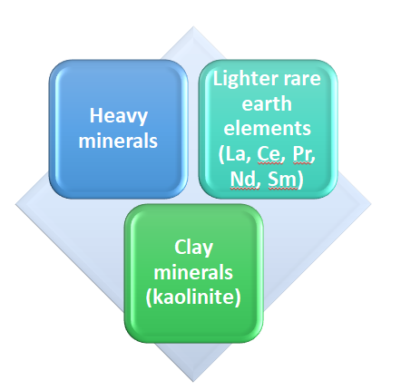
Introduction
Significantly 3 types of minerals and elements in RE.
RE have important heavy minerals such as magnetite, ilmenite, and rutile enhance its economic importance.^{[3]}
The RE contains 8-10 percent of ilmenite. ^{[3]}
[3]Spotlight on Puttalam: Aussie company buys Lankan ilmenite deposit for a pittance," *Daily Mirror*, Feb. 17, 2023. [Online]. Available: https://www.dailymirror.lk/print/expose/Spotlight-on-Puttalam-Aussie-company-buys-Lankan-ilmenite-deposit-for-a-pittance/333-250736.
3

Slide 5
Introduction
Ilmenite, a heavy, iron-black mineral composed of iron and titanium oxide (FeTiO₃).
Key source of titanium/titanium dioxide.
Characteristics properties of titanium dioxide (TiO₂) such as High refractive index, UV-blocking properties, Phocatalytic activity making it important in industrial and consume application. ^{[4]}
Titanium dioxide is used in paints, paper, toothpaste, sunscreen and even food colouring. ^{[5]}
[4] A. Shah, D. Ban, and A. Kumar, "Photocatalytic TiO2-Based Nanostructures as a Promising Material for Diverse Environmental Applications: A Review," Bioengineering, vol. 5, no. 1, p. 7, 2023. [Online]. Available: https://www.mdpi.com/2624-781X/5/1/7.
[5] "Mineral Sands Products & Sales," *Mineral Commodities Ltd.*, 2023. [Online]. Available: https://www.mineralcommodities.com/products-sales/mineral-sands/.
4

Slide 6
Research problem
There are currently no efficient technologies for extraction and purification of red earth.
Difficulties in extraction of Tio2 from ilmenite found in red earth due to the complex mineral structure of ilmenite and the presence of impurities.
5

Slide 7
Objectives
Major Objective
The main goal is to extract titanium dioxide (TiO₂) from ilmenite found in the red earth deposits of the Aruwakkalu region in Sri Lanka.
Specific Objectives
To develop and optimize a chemical extraction method for producing titanium dioxide, focusing on minimizing impurities such as iron and aluminum.
To evaluate and optimize a chemical extraction method for titanium dioxide (TiO₂) by minimizing the Fe and Al contamination.
6

Slide 8
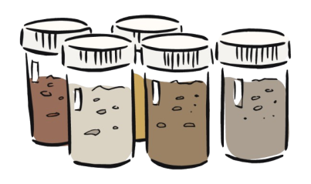
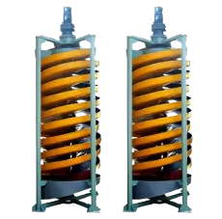

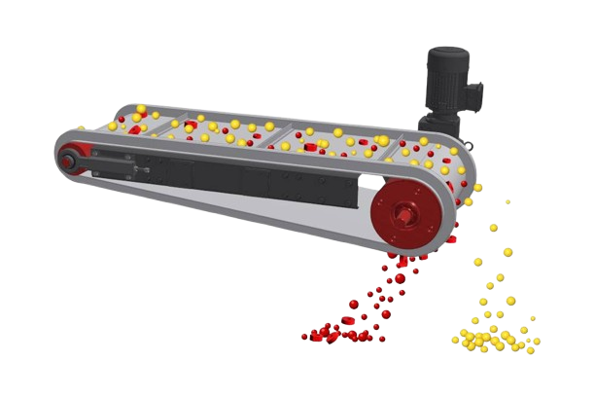
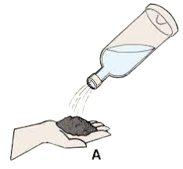
Materials and Methods
Middle & concentrate
Heavy minerals
Magnetic minerals
Sampling
Humphrey spiral Concentrator
Shaking table
Magnetic separator
Clay mineral and organic material
Light minerals
Non-magnetic minerals
Water washing
7

Slide 9
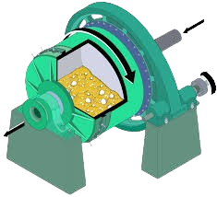
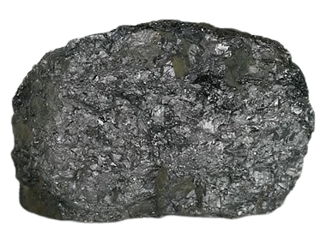
Materials and Methods
< 53 μm powdered sample
Alkaline leaching
Al2​O3​+2NaOH→2NaAlO2​+H2​O
Ilmenite
Ball milling
EDTA selective iron removal
< 53 μm powdered sample
9

Slide 10
Expected Outcome
This study focuses on developing an efficient method for TiO₂ extraction, overcoming disturbance from iron and aluminum oxide surface coating.
Minimize the operational cost and environmental impact during the extraction process.
NaOH alkaline leaching will remove aluminum impurities, while EDTA will selectively remove iron.
10

Slide 11
References
[1] L. Gunatilake et al., "Map of the Holcim limestone excavation site, Eluwankulama, Aruwakkalu Forest, Puttalam," *ResearchGate*, 2010. [Online]. Available: https://www.researchgate.net/figure/Map-of-the-Holcim-limestone-excavation-site-Eluwankulama-Aruwakkalu-Forest-Puttalam_fig20_256454738.
[2] P. M. D. C. Perera, "Study on the properties of steel reinforcement bars produced in Sri Lanka," University of Moratuwa Institutional Repository, 2020. [Online]. Available: http://dl.lib.uom.lk/handle/123/17423.
[3] Spotlight on Puttalam: Aussie company buys Lankan ilmenite deposit for a pittance," *Daily Mirror*, Feb. 17, 2023. [Online]. Available: https://www.dailymirror.lk/print/expose/Spotlight-on-Puttalam-Aussie-company-buys-Lankan-ilmenite-deposit-for-a-pittance/333-250736.
[4] A. Shah, D. Ban, and A. Kumar, "Photocatalytic TiO2-Based Nanostructures as a Promising Material for Diverse Environmental Applications: A Review," Bioengineering, vol. 5, no. 1, p. 7, 2023. [Online]. Available: https://www.mdpi.com/2624-781X/5/1/7.
[5] "Mineral Sands Products & Sales," *Mineral Commodities Ltd.*, 2023. [Online]. Available: https://www.mineralcommodities.com/products-sales/mineral-sands/.
[6] "Mineral resources from Sri Lanka," *Sri Lanka Export Development Board*, 2020. [Online]. Available: https://www.srilankabusiness.com/blog/mineral-resources-from-sri-lanka.html.
11

Slide 12
Thank You
12

